Slide 1

Ex Libris Overview
Dvir Hoffman
VP, Product Management & Marketing
Notes:
0

Slide 2
Ex Libris in Figures
  110 new customers
  5,500+ institutions
  560 employees (up from 530)
  Primo - 2100 institutions
  Alma – 370 institutions
  2043 institutions using our cloud (at least one product)
  ProQuest agreement
  Salesforce CRM, Cloud Status Portal, Developers Network
1
© Ex Libris Ltd., 2014 - Internal and Confidential

Slide 3
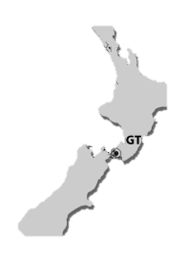
Global Increase in Resources
80 employees
130 employees
Denmark
UK
Poland
Czech Republic
Hungary
Ukraine
40 employees
Chicago
France
Germany
Spain
Korea
Boston
Italy
China
Japan
Israel
Taiwan
Mexico
310 employees
Vietnam
Thailand
Colombia
Brazil
Singapore
Chile
Australia
Headquarters
Company Offices
Distributors

Slide 4

Working with the Entire Community
  Supporting open access
  Members of the PREMIS Committee
  Taking an active role in NISO initiatives:
    Open Discovery Initiative (ODI)
    Open Access Metadata and Indicators (OAMI)
    Knowledge Base And Related Tools (KBART)
    Demand Driven Acquisition of Monographs Working Group Roster (DDA)
    NCIP Standing Committee
    Standard Interchange Protocol (SIP)
  Participating in research projects:
    PrestoPRIME
    SCAPE

Slide 5
Channels of collaboration with our customers
  Voting process for enhancements
  Product working groups
  IGeLU & ELUNA mailing lists
  Primo ranking advisory group
  Alma community zone advisory group
  Rosetta advisory group
  Special interest working group on Interoperability
  Special interest working group on Linked Open Data

Slide 6
  Alma Overview

Slide 7
Alma Main Milestones in Recent Year
  370 institutions worldwide
  (176 signed in 2013)
  130 live institutions
  (10,000+ active staff users)
  First live consortia
  (Orbis Cascade Alliance)
  12 monthly updates
  (500+ enhancements)
  40% of institutions switching from non-ExL ILS
  BIBSYS (104 institutions) – all of Norway
© Ex Libris Ltd., 2014 - Internal and Confidential

Slide 8
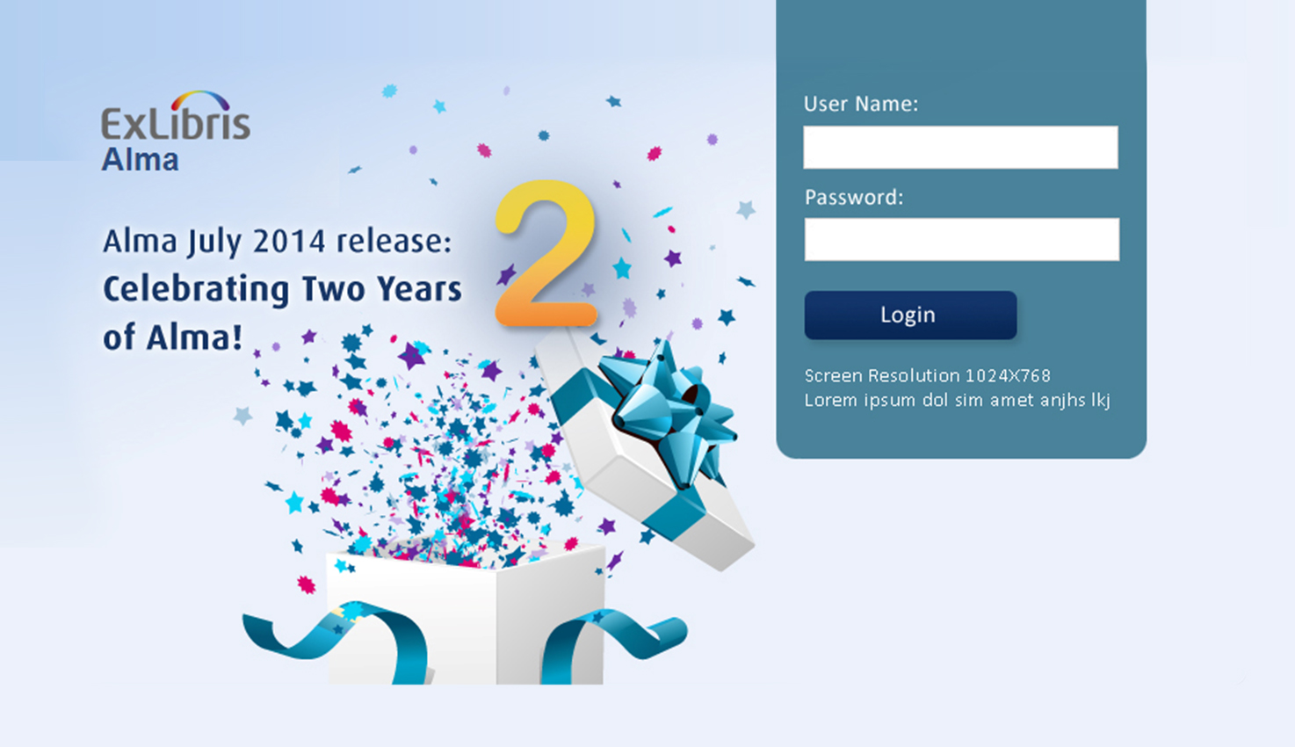
Where is Alma Today?
132
Live Institutions
27
Releases
370
Signed Institutions
10,000+
Staff users
15,000,000+
Loan transactions

Slide 9
Expected Growth in Live Alma Institutions

Slide 10

















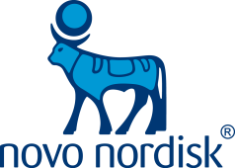























Alma Transforms Libraries of all Sizes
132 institutions

Slide 11



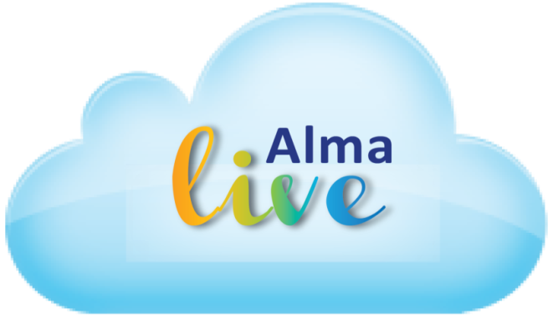




Alma Transforms Consortia of all Sizes
37 institutions
104 institutions
32 institutions
132 institutions
19 institutions
24 institutions
7 institutions
26 institutions

Slide 12
  Alma value Proposition

Slide 13
Road to Next Generation Library Services
Constituents
Present Services
Next Gen Services
Users
Discovery
& Access
Personalized Experience
Partners
Resource Sharing
Joint Collection Building
Parent
Institution
Building
Collections
Providing Additional Value
Suppliers
Purchasing
Demand & Usage-Driven
Scholarly Community
Discovery
& Access
Research Involvement
Notes:
12
So, now that we’ve talked about the various relationships the library has, let’s talk about what that means for next generation library services, and how we will deliver services to them in light of the new framework.
In general, in one sentence, if I can, it means “TAKING THE RELATIONSHIP TO THE NEXT LEVEL.” And each constituent has a different type of relationship with the library. Let’s start with users. The present way of working with users is all about what we call “Discovery and Access”. Users connect to the library to get access to information or knowledge. Next generation library services takes this relationship to the next level. In this case, an example could be providing a personalized experience. So it’s not just about delivering access – we’re moving to a much more personalized access, one that is driven by the needs of the user.
If you look at partners, typically, there is a “resource-sharing” relationship. I share resources with you, for example. Inter Library Loans. I provide a book to another library who requests it. Next generation library services means again, taking this relationship to the next step or to the higher level of relationship. In this case, for example, “Joint-Collection Building”: So instead of just sharing my books with partners, we are building our collection together, jointly, so instead of having two books in two locations, I’m going to have a single book, in a single location, maybe even off premise, but now I’m not just sharing, I’m becoming more efficient by jointly-developing my collection. As you can see this is a higher level of relationship between the library and partners. This is just one example – there are many other examples when it comes to partners.
Parent institution? Here, the traditional way is that libraries provide the collection development. Libraries are responsible for developing the knowledge base of the institution. Next generation means moving towards demonstrating value or adding value to the institution in a measurable way. And in this case, it’s about connecting to the mission statement, the missions of the parent institution, whatever they may be. Whether teaching or research, really helping the institution meet those goals in a much better way.
Suppliers? Traditionally, we just have a relationship where we purchase from them. What does that mean? I subscribe to an electronic package. That’s the relationship. I activate an electronic package. Versus a next generation relationship means that now the publisher knows what the demand is for a particular package. The publisher knows what the users want, what the usage of your users in the library is. Now they will be able to provide you content that is much more on-demand and personalized to that library. So now, instead of buying a package, and you know, it will be a very generic package, now you will move to a more selective mode, a more customized relationship moving away from what the publisher wants to provide, to what the user wants the publisher to provide. A small nuance, but a huge difference.
And the scholarly community, in the past, it’s about faculty looking for books, articles, and the library provides the discovery or access of those materials. A higher level of relationship is really about being much more involved in the relationship, where libraries, who are experts in knowledge across various disciplines, know what research can help the faculty before they come to it, allowing them to find what they need In a much more effective manner.
12

Slide 14



The Strategy – Unified Resource Management
CONSOLIDATE
OPTIMIZE
EXTEND
the
frameworks
through collaboration
the
range of services
Notes:
13
After talking to many of our customers over the last two to three years, we were able to take that feedback to design a framework that we are referring to as the UNIFIED RESOURCE MANAGEMENT framework. It basically takes the steps that a library should take to get to the next generation framework, and we’ve defined that in three steps:
The first one is about consolidation, the second is optimise, and the third is extend. We believe that if a library followed this strategy, where they consolidated their frameworks, optimise through collaboration, and finally extend the range of services, they’ll be able to achieve that transition to next generation library services.

Slide 15
The Strategy – Unified Resource Management
CONSOLIDATE
OPTIMIZE
EXTEND
the
frameworks
through collaboration
the
range of services
Notes:
So let’s explain what we mean by each one of those elements. We’ll start obviously with the consolidate step.

Slide 16

The Current Resource Silos Challenges
    Duplicate
    Data
Print
Materials
Electronic
Materials
Digital
Materials
    Duplicate Workflows
Silo 1
Silo 2
Silo 3
Notes:
I’d like to go in and talk about the architecture. We now have the model where everything is inventory based. The product holds inventory on anything that you own and we are going to track it. This is an example of how we can do amazing things with data that lives in the cloud. Specifically in this instance, it exists within the community zone. The community zone is the data that you own that is local to your library. In the data services zone we have the ckb. For those of you that have metalib you will understand what this is. We have had years of building the ckb. The community catalog will be populated with lc and blc and we have the global authorities file that will be seeded from or linked to the lc global authority file and mesh. We’re also looking at other relationships with other international authority files and some art vocabularies. In general release it will be LC and mesh. So how does this work?
A library purchases the trial and uses present day processes to pull in metadata. So this can be from oclc, it can be from ybp, and the inventories then attach to that metadata. The library purchases the collapse. Alma checks the community zone for metadata that would work for this version of the collapse. It will, or one can, attach ones inventory to that record. What’s great about that is while this record is enhanced by the community, the enhancement happens automatically. When one activates the package from academic search premier from EBSCO, Alma knows what title exists within that package and also understands the current data.
So as EBSCO adds 15 titles, Alma takes care of that automatically. There is no longer the updating of knowledge bases every 2 weeks. No longer the need to tell if a record has been turned on—it happens automatically within the product. And then also with authorities—updated automatically. Because authority work is so difficult and tedious, some institutions do it every two months and spend 3 or 4 days checking authorities and grouping authorities—no longer necessary. It is done automatically. If an authority record is changed in lc it will be populated in Alma automatically. This is a form of linked data. What’s cool about this is say something in the next couple weeks happens in the news, and an authority record changes. The authority record changes in lc, it goes to Alma, and filters to any record in the community zone, catalog, or local record. The only time there is an interaction with a librarian is if there is a split in the record. If it requires a choice. In this case, the system tells a librarian it needs to be done by their role. It would be pushed to their task list. I’ll talk about this more as I get into the demo.
One thing I like to do here is mention that Alma, a URM, is a back office tool. It is not an ILS. It is next gen library services. It encompasses everything the library needs to do to watch over and run their inventory. It is not an opac nor does it need one. It’s better than that. One simply places a discovery layer over Alma. We are saying that Alma is discovery layer agnostic, you can use any discovery layer you like, but also to be clear that our discover layer primo is being developed next to Alma and in many cases you have developers working on both sides. We will work as closely as we can to offer up API and web services to bring us close to the requirements for ILS DI. To go beyond that, though, primo will have the complete integration.

Slide 17


Efficiency: Unified Resource Management
    Unified
    Data
Fulfillment
    Unified Workflows
Metadata Management
Acquisitions
    Unified Management
Selection
Notes:
I’d like to go in and talk about the architecture. We now have the model where everything is inventory based. The product holds inventory on anything that you own and we are going to track it. This is an example of how we can do amazing things with data that lives in the cloud. Specifically in this instance, it exists within the community zone. The community zone is the data that you own that is local to your library. In the data services zone we have the ckb. For those of you that have metalib you will understand what this is. We have had years of building the ckb. The community catalog will be populated with lc and blc and we have the global authorities file that will be seeded from or linked to the lc global authority file and mesh. We’re also looking at other relationships with other international authority files and some art vocabularies. In general release it will be LC and mesh. So how does this work?
A library purchases the trial and uses present day processes to pull in metadata. So this can be from oclc, it can be from ybp, and the inventories then attach to that metadata. The library purchases the collapse. Alma checks the community zone for metadata that would work for this version of the collapse. It will, or one can, attach ones inventory to that record. What’s great about that is while this record is enhanced by the community, the enhancement happens automatically. When one activates the package from academic search premier from EBSCO, Alma knows what title exists within that package and also understands the current data.
So as EBSCO adds 15 titles, Alma takes care of that automatically. There is no longer the updating of knowledge bases every 2 weeks. No longer the need to tell if a record has been turned on—it happens automatically within the product. And then also with authorities—updated automatically. Because authority work is so difficult and tedious, some institutions do it every two months and spend 3 or 4 days checking authorities and grouping authorities—no longer necessary. It is done automatically. If an authority record is changed in lc it will be populated in Alma automatically. This is a form of linked data. What’s cool about this is say something in the next couple weeks happens in the news, and an authority record changes. The authority record changes in lc, it goes to Alma, and filters to any record in the community zone, catalog, or local record. The only time there is an interaction with a librarian is if there is a split in the record. If it requires a choice. In this case, the system tells a librarian it needs to be done by their role. It would be pushed to their task list. I’ll talk about this more as I get into the demo.
One thing I like to do here is mention that Alma, a URM, is a back office tool. It is not an ILS. It is next gen library services. It encompasses everything the library needs to do to watch over and run their inventory. It is not an opac nor does it need one. It’s better than that. One simply places a discovery layer over Alma. We are saying that Alma is discovery layer agnostic, you can use any discovery layer you like, but also to be clear that our discover layer primo is being developed next to Alma and in many cases you have developers working on both sides. We will work as closely as we can to offer up API and web services to bring us close to the requirements for ILS DI. To go beyond that, though, primo will have the complete integration.

Slide 18









Consolidated Workflows - Examples
Selection
Digital Asset Mgmt
Electronic Mgmt
Physical Mgmt
Metadata Mgmt
Link Resolution
Fulfillment
User-driven collection development
Cross-resource type selection
Combined acquisition and activation
Digitization on demand
Usage-driven evaluation & renewal
Overlap analysis – D, E, & P
Unified fulfillment – D, E, & P
Unified Resolving Services
Notes:
Here are examples of what we’ve done as a result of optimizing those workflows. We took all of these systems from left to right here, selection, print management, electronic management, digital asset management, metadata management, link resolution, and discovery. Those were all silos, and we’re now unifying into one unified system and platform.
Now by doing that, we’re not only creating a huge efficiency in the processes, we enabled new types of work flows that couldn’t have existed in the past or were very manual in nature. Such as “Overlap Analysis”. Now that we have all the information for the Print, Electronic, and Digital together in one place, I can easily perform the overlap analysis to see, “Maybe I’m trying to purchase a book in print that I already have access to via partnership, or maybe I’m trying to license a subscription to content that I already have in a different format.” Or if I want to talk about cross-format selection, I can talk about that. In the past, print and electronic were siloed, disconnected. Today, now I can do that in a cross-format fashion. I can combine acquisition and activation. Activation is the notion within electronic content, you have to “activate” the resource or subscription, while acquisition is more print oriented, now we can combine the two together to not only unify the workflows, but to also create new, more efficient workflows that didn’t exist in the past.

Slide 19
The Strategy – Unified Resource Management
CONSOLIDATE
OPTIMIZE
EXTEND
the
frameworks
through collaboration
the
range of services
Notes:
18
Now we’ve talked about Consolidating the frameworks, let’s now move to discussing how we will optimise these processes through collaboration.

Slide 20

Unlocking the Value of the Library
Optimization
Library optimization: Networked library system
  Optimized
  User Experience
    Access from anywhere
    On-demand fulfillment
  Optimized
  Services & Workflows
    Library process management
    Shared data and collection
  Optimized
  Library Resources & Data
    Shared resources
    Enriched content
    Intelligence & Analytics
  Optimized
  Infrastructure
    Network-level architecture
    Cloud based service
    Open interfaces & open data
Automation
Library automation: Integrated library system
Notes:
If you build out the animation, the first thing that you’ll notice is that we believe that the industry needs to shift from automation. Our industry for many years was all about library automation. And here, what was also known as Integrated Library Systems, they actually integrated systems in the past. Now, we are seeing a shift towards, Library optimization. Ex Libris is driving this shift in the industry, moving from automation to optimization, and moving from Integrated Library Systems to the Networked library system.
And the way we achieve that is by following the four steps laid out here.
The first is to optimise the infrastructure. This means moving to a network-level architecture and delivering cloud-based services. In other words, achieving the network effects by moving to network-level architecture. So that’s the first step: providing library management with cloud-based services.
The next step is where we optimise the library’s resources and data. Taking a look at Shared Resources in the light of intelligent analytics. How do we look at the resources we have and begin to use them in a way that is intelligent. And in a way that is shared and collaborative.
The third step is to optimise the services and workflows, because as you remember, we’ve optimised the resources and the data, and now we have to look at the services and workflows. And here, it’s really about the shared data and collection, and library process management, and how we collaborate to optimise these workflows.
And finally, although it’s a management system, we have to always remember the user experience. Everything we do on the backend of this management has to translate into a better user experience for our customers, to the end users. And in this case, we’re talking about things such as “Access from anywhere” using mobile devices and things of that nature. But even more importantly, the on-demand. The notion that it’s an on-demand world where it’s not about buying a book for a library JUST IN CASE someone needs it. But it’s buying a book JUST IN TIME, moving to a user-driven acquisition environment. On-demand, that’s where we are fulfilling these needs.
So that’s the paradigm shift that we’re referring to, from automation to optimization, which is critical to the process of moving to next generation library services.

Slide 21
The Strategy – Unified Resource Management
CONSOLIDATE
OPTIMIZE
EXTEND
the
frameworks
through collaboration
the
range of services
Notes:
20
So we’ve discussed consolidating the frameworks, and optimizing the workflows through collaboration, let’s talk about extend, and what does that mean.

Slide 22





The Alma Developers Platform
Course
Management
Custom Apps
Material
Vendors
Discovery &
Delivery
Student Info
Systems
Resource Sharing
Alma Developers Platform
Financial Systems
Cloud Integration Templates
Apps &
Extensions
Alma
Developers Network
Web
Services
Publishing Services
Adapters & Interfaces
Export & Import Services
Alma Extensible Architecture
Notes:
As you know Ex Libris pioneered the concept of “Open Platform” in the industry years before other vendors started to open their APIs….
Since Alma is a cloud-based solution, we know we have even stronger responsibility to deliver a platform that gives our customers the flexibility and control over their data that they expect ….
That is why we are developing the Alma developers platform – or the Alma API platform – where we’ll deliver many different options such as web-services, out of the box interfaces and ability for developers to create extensions that fit the unique needs of their institution
Last note – we also plan to deliver the “next generation of EL Commons” as part of the new API platform with existing new capabilities like the API console that will allow developers to actually test API on the Developers portal itself.
Let’s move know to the 4th success factor which is Configurability & Scalability and specifically I want to talk about our “Collaborative Network” concept ….

Slide 23










Alma Developers
Publishing
APIs
Data Extract & Import
Course
Management
Bursar
Systems
Finance
Systems
Mobile
Student
Info
Systems
Bulk BIB Record Manipulation
Resource
Sharing
Vendor
Systems

Slide 24
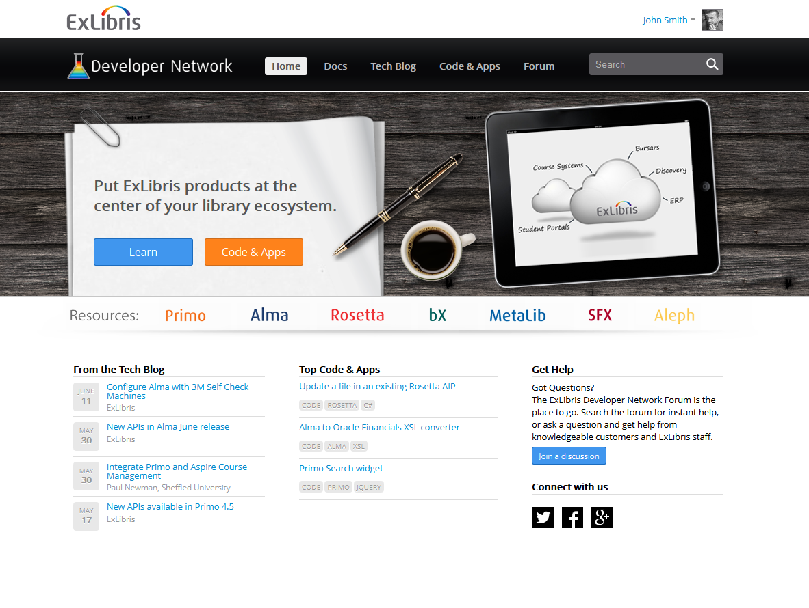
New Ex Libris Developer Network

Slide 25







API’s In Action by Our Customers
Patron card via portal
Custom Portal/discovery
Real time synchronization with SIS
Sentry Security Gate check
Cash payment integration
Course Reading List for Mobile
Reading Lists integration

Slide 26


Alma Cloud

Slide 27


Ex Libris Worldwide Data Centers
Chicago
Amsterdam
Singapore

Slide 28


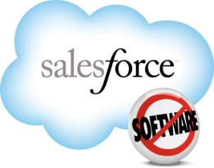












Running on Industry leading Cloud Datacenter
© Ex Libris Ltd., 2014 - Internal and Confidential

Slide 29
Unified by Design

Slide 30
Unified Architecture
Primo
Discovery
Delivery
Community zone
Alma
DATA SERVICES
Resource Management
Acquisitions
Business Intelligence
and Analytics
Cataloging
Fulfillment
Infrastructure
Cloud
Infrastructure
Security
Workflow
Engine
Open
Platform
Notes:
Alma is a unified resource management system, incorporating an exception-based workflow model to support the end-to-end management of print, electronic resources and local digital collections. Rather than integrating a range of existing, disparate services, Alma has been designed from the ground-up to break down the traditional silos between formats and create additional efficiencies to reduce the cost of ownership and provide additional bandwidth for library staff.
This approach enables for example:
Cross format Selection and acquisition as well as e-resource activation based on a single KnowledgeBase
Consistent workflows across formats
Metadata for e-resource titles available in the metadata management system
Link resolution built into the inventory
Usage, cost per use, and other tools to evaluate value of e-resources when making renewal or cancellation decisions
Single source for reporting

Slide 31
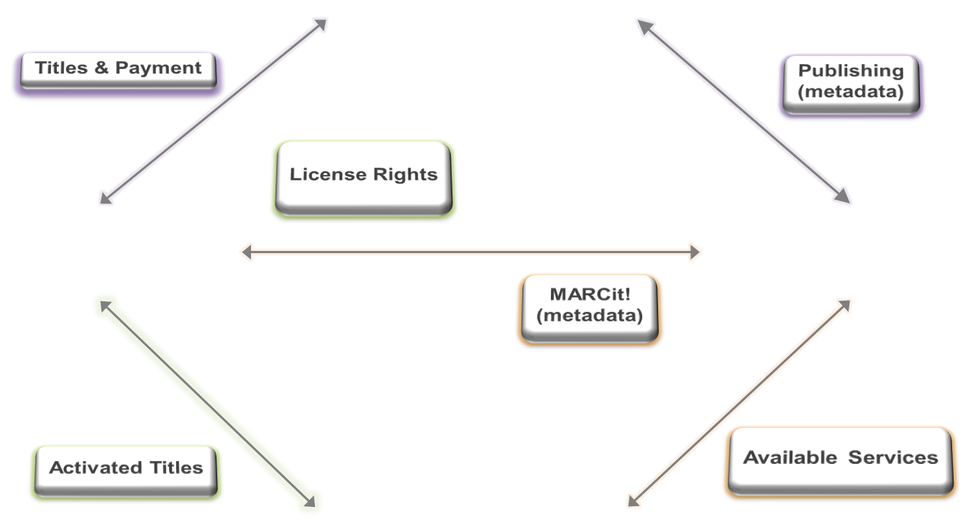
Managing e-Resources Without Alma
ILS
ERM
Discovery
ERM
Link Resolver
Notes:
One of the best examples of this is illustrated when you look at the changes Alma introduces for managing e-resources. Even for those of you who have an erms environment that is integrated with your ILS, the steps involved in managing e-resources across what are effectively separate systems – the ILS, the ERM and your link resolver – often requires a multiplicity of steps with staff handing off portions of the workflow across each of these 3 systems as they first select and acquire the resource,

Slide 32
Managing e-Resources with Alma
Real Case
BC
Total # of Separate Handoffs Required to Manage e-Resources
0
ERM
Alma
Link Resolver
ILS
Notes:
Contrast this to the unified management environment of Alma which requires NO handoffs between separate systems::
- selection, acquisition and activitation of electronic resources is based on a single Knowledgebase which is linked to metadata describing the resources
- The workflows for library staff are consistent with workflows for managing print resources, so not only do staff not need to use separate systems, there is also no need for staff to be familiar with different UI environments.
- Link resolution is built into Alma so libraries do not need to maintain a separate link resolved and many of the steps involving activation and publication of resources for discovery can be automated in Alma providing further efficiencies
- Because Alma is a unified service and includes a robust business intelligence and reporting tool, usage information and cost per use is easy to determine and can, in fact, be directly integrated into the staff workflow for evaluation ensuring more effective decision making.

Slide 33
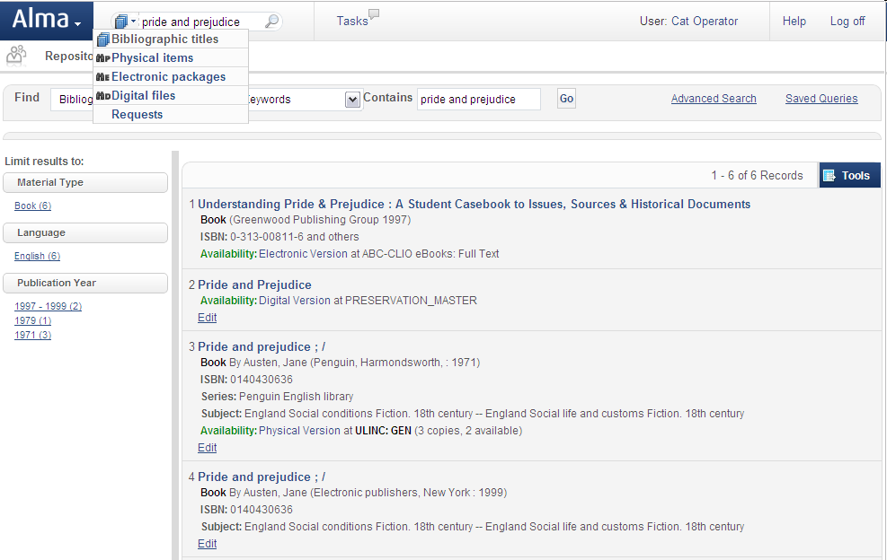

Single Search
Single search across all resource types
Resource types managed together
© Ex Libris Ltd., 2014 - Internal and Confidential
Notes:
Replaced with more updated screenshot

Slide 34
Cataloging
Primo
Discovery
Delivery
Community zone
Alma
DATA SERVICES
Resource Management
Acquisitions
Business Intelligence
and Analytics
Cataloging
Fulfillment
Infrastructure
Cloud
Infrastructure
Security
Workflow
Engine
Open
Platform
© Ex Libris Ltd., 2014 - Internal and Confidential
Notes:
Throughout the course of the presentation today, you will see the extensive functional capabilities available today with Alma. I wanted to take a few minutes and highlight just a few of the unique capabilities that our solution will provide.

Slide 35
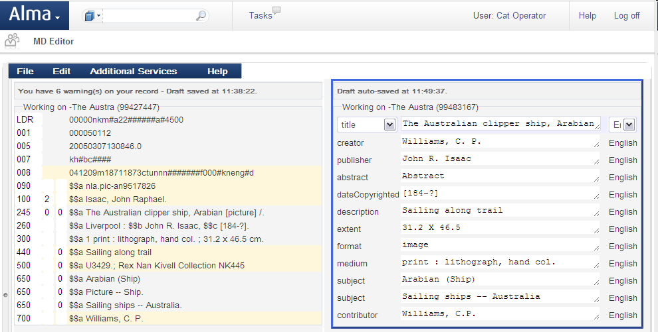
Metadata Management
© Ex Libris Ltd., 2014 - Internal and Confidential
Notes:
Alma has been designed to be metadata-agnostic and extensible. Today, Alma supports multiple metadata schemas including: MARC21 and Dublin Core with MODS planned for next year. Our support extends beyond the editing interfaces to also include field validation and contextual help. This facility provides Alliance members with a great way to describe your unique local collections according to your own needs.

Slide 36
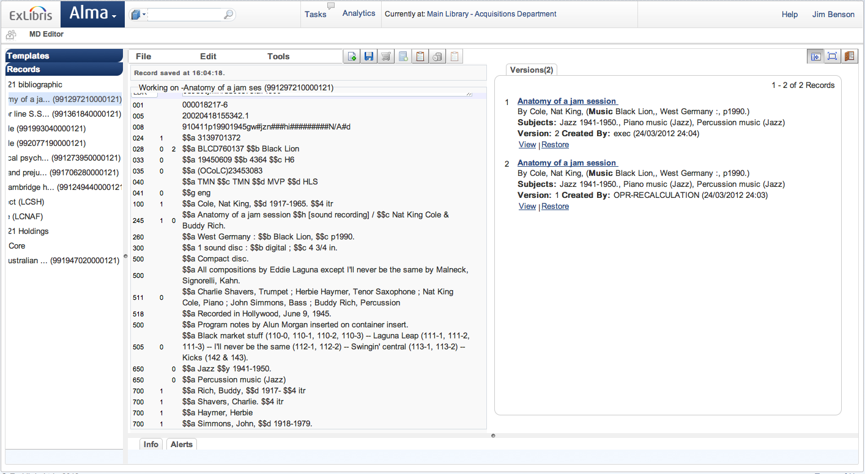
Metadata Management
© Ex Libris Ltd., 2014 - Internal and Confidential
Notes:
Alma also provides auto-save with record versioning and recovery options.

Slide 37
Real Use Case - Metadata Management
Real Case
75% Reduction in Records Import Work
FHSU regularly imports MARC records as part of their cataloging workflow
Used Alma one-time setup for the import of the MARC with appropriate rules for validation, duplicate detection, normalization, etc.
75% of the work required with their traditional ILS eliminated due to the automation built into Alma.

Slide 38
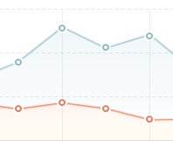

Analytics
Primo
Discovery
Delivery
Community zone
Alma
DATA SERVICES
Resource Management
Acquisitions
Business Intelligence
and Analytics
Cataloging
Fulfillment
Infrastructure
Cloud
Infrastructure
Security
Workflow
Engine
Open
Platform
© Ex Libris Ltd., 2014 - Internal and Confidential
Notes:
One of the fundamental elements of Alma’s design is the sophisticated and pervasive use of business intelligence and analytics capabilities

Slide 39
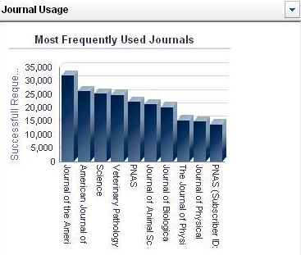
Alma Analytics
Sophisticated analysis, informed decision making
Analytics data as part of daily work
Suite of industry-relevant report templates
Diverse customization options
Near real-time
Role-based
Operational and analytics
Customizable and intuitive
ARL reports
Notes:
These capabilities are embedded throughout the system and are designed to support informed decision making for library operations. In addition to industry standard and custom reports, analytics are delivered to staff based upon their role at the point of need within a given workflow and can also be displayed on the users Dashboard.

Slide 40
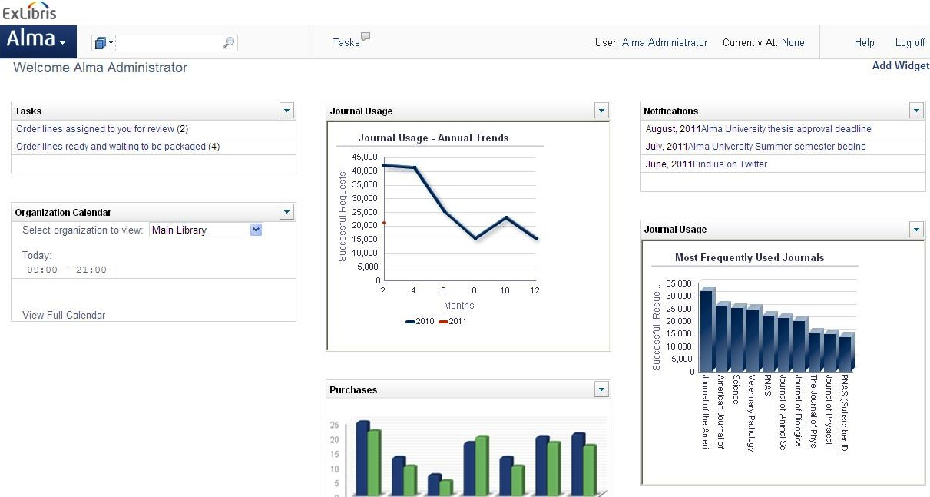
Alma Analytics
Usage
Statistics
Notifications
Staff
Tasks
Library
Calendar
© Ex Libris Ltd., 2014 - Internal and Confidential
Notes:
ANALYTICS IN USER DASHBOARD
Alma home page is built as a configurable dashboard which displays a variety of elements, based on the user’s roles.
The elements are operational, like the notification section and the tasks sections. From the Tasks section the user is redirected to his specific list of tasks where he can trigger the relevant workflow.
Besides the operational section the user is presented with analytics according to common business logic and processes. In the first stage we are working on producing USTAT-like widgets which display the usage statistics of e-journals, in various dimensions, split by journals, periods, and number of requests. It is going to be presented by Barbara as part of our demos in ALA.
Adding a widget to the dashboard is simple and intuitive (demo).

Slide 41
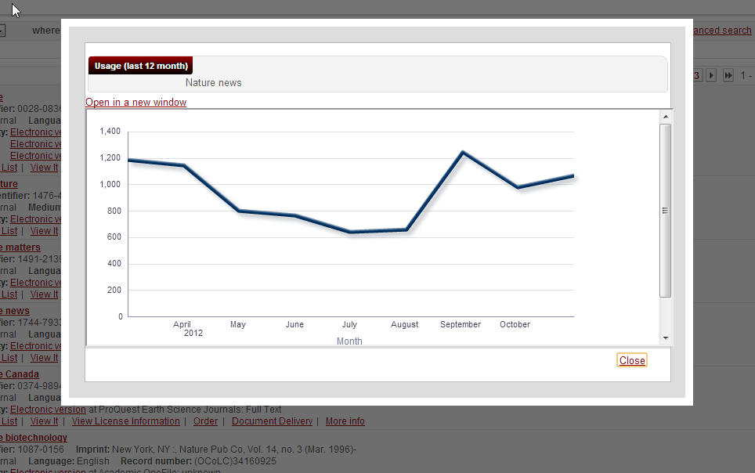
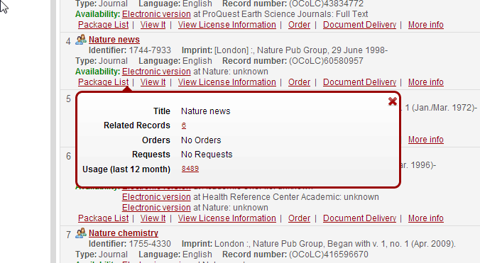
Embedded Usage Analytics
© Ex Libris Ltd., 2014 - Internal and Confidential

Slide 42
Analytics Vision
Prescriptive Analytics
HOW CAN
we make it happen?
Difficulty
Predictive Analytics
WHAT WILL
Happen?
Descriptive Analytics
HOW should we take action?
Ability to model,
manage, and adapt
WHY
Did it happen?
Data-driven planning and forecasting
WHAT happened?
Managed Reporting
Dashboard for managers and analysts
Ad Hoc Reporting
Analytics
Increase in ad hoc reporting and Information on demand
Dashboards
Scorecards & Benchmarking
Primarily batch and some ad hoc reports
Value
Hindsight
Insight
Foresight
Notes:
Would like to note that we are ‘moving up the curve’…

Slide 43
Real Use Case
Real Case
3,000 USD Saving in Two Days
Two days after moving into production, Fort Hays ran the Analysis report within Alma Analytics
Discovered they were double ordering a journal titles
Immediately saved 3,000 USD/Year
They expect the saving to increase significantly to tens of thousands of dollars.

Slide 44
Community Zone
Primo
Discovery
Delivery
Community zone
Alma
DATA SERVICES
Resource Management
Acquisitions
Business Intelligence
and Analytics
Cataloging
Fulfillment
Infrastructure
Cloud
Infrastructure
Security
Workflow
Engine
Open
Platform
© Ex Libris Ltd., 2014 - Internal and Confidential
Notes:
One of the fundamental elements of Alma’s design is the sophisticated and pervasive use of business intelligence and analytics capabilities

Slide 45

Community Zone
The Alma Community Zone
The Alma Institution Zone
Global Authorities
Local Catalog
Community Catalog
Inventory
Hamlet
The Trial
Central KnowledgeBase
Academic Search Premier
Academic Search Premier
Notes:
Loaded by now: EBL, SkillSoft, Cassalini Libri
To be loaded soon: ProQuest , Springer, CUP, ACLS
I’d like to go in and talk about the architecture. We now have the model where everything is inventory based. The product holds inventory on anything that you own and we are going to track it. This is an example of how we can do amazing things with data that lives in the cloud. Specifically in this instance, it exists within the community zone. The community zone is the data that you own that is local to your library. In the data services zone we have the ckb. For those of you that have metalib you will understand what this is. We have had years of building the ckb. The community catalog will be populated with lc and blc and we have the global authorities file that will be seeded from or linked to the lc global authority file and mesh. We’re also looking at other relationships with other international authority files and some art vocabularies. In general release it will be LC and mesh. So how does this work?
A library purchases the trial and uses present day processes to pull in metadata. So this can be from oclc, it can be from ybp, and the inventories then attach to that metadata. The library purchases the collapse. Alma checks the community zone for metadata that would work for this version of the collapse. It will, or one can, attach ones inventory to that record. What’s great about that is while this record is enhanced by the community, the enhancement happens automatically. When one activates the package from academic search premier from EBSCO, Alma knows what title exists within that package and also understands the current data.
So as EBSCO adds 15 titles, Alma takes care of that automatically. There is no longer the updating of knowledge bases every 2 weeks. No longer the need to tell if a record has been turned on—it happens automatically within the product. And then also with authorities—updated automatically. Because authority work is so difficult and tedious, some institutions do it every two months and spend 3 or 4 days checking authorities and grouping authorities—no longer necessary. It is done automatically. If an authority record is changed in lc it will be populated in Alma automatically. This is a form of linked data. What’s cool about this is say something in the next couple weeks happens in the news, and an authority record changes. The authority record changes in lc, it goes to Alma, and filters to any record in the community zone, catalog, or local record. The only time there is an interaction with a librarian is if there is a split in the record. If it requires a choice. In this case, the system tells a librarian it needs to be done by their role. It would be pushed to their task list. I’ll talk about this more as I get into the demo.
One thing I like to do here is mention that Alma, a URM, is a back office tool. It is not an ILS. It is next gen library services. It encompasses everything the library needs to do to watch over and run their inventory. It is not an opac nor does it need one. It’s better than that. One simply places a discovery layer over Alma. We are saying that Alma is discovery layer agnostic, you can use any discovery layer you like, but also to be clear that our discover layer primo is being developed next to Alma and in many cases you have developers working on both sides. We will work as closely as we can to offer up API and web services to bring us close to the requirements for ILS DI. To go beyond that, though, primo will have the complete integration.

Slide 46
Acquisitions
Primo
Discovery
Delivery
Community zone
Alma
DATA SERVICES
Resource Management
Acquisitions
Business Intelligence
and Analytics
Cataloging
Fulfillment
Infrastructure
Cloud
Infrastructure
Security
Workflow
Engine
Open
Platform
© Ex Libris Ltd., 2014 - Internal and Confidential
Notes:
Alma is optimized for the needs of consortia by supporting highly flexible policies, customizable processes, joint selection, acquisitions and more.
Alma supports patron and demand-driven selection and acquisition models, offering seamless integration with Primo. These capabilities will enable the Alliance to control the exponentially increasing costs of materials by transitioning from a just-in-case to just-in-time collection development methodology – all without imposing additional overhead on library staff.
In contrast to legacy solutions, Alma utilizes an exception-based workflow model. In this model, common tasks, particularly those in acquisitions are fully automated. Staff are involved only when there are exceptions to the parameters defined by the Alliance and its members.

Slide 47
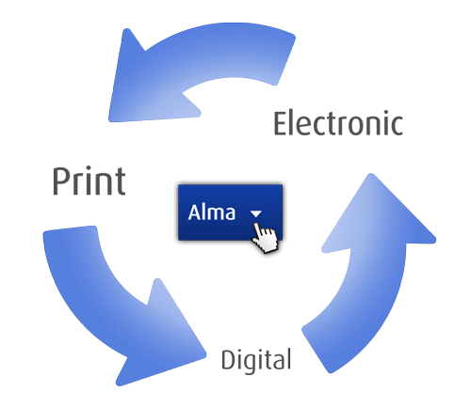
Acquisitions
Streamlined mixed resource purchasing models
Integrated claims management
Budget visibility enabling smart decision making
Unified processes for all material types
Unified processes
Review and approval steps
Various sources
Notes:
As a unified solution, streamlined acquisitions workflows are provided for all types of resources: print, electronic resources and digital collections. As mentioned previously, embedded analytics and other time saving capabilities such as integrated claims management are incorporated into each workflow.

Slide 48








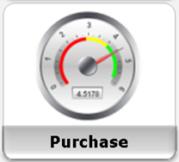
Automated Acquisitions Process
Vendor A
Vendor B
Vendor C
Wizard Based Vendor EOD Profile Creation
Auto EOD Import and Processing
Rules validations
And Auto PO Generation
Track POs
and Budget
Notes:
At the beginning of the lifecycle management process with selection and evaluation, Alma provides a number of tools to assist staff including incorporating shared holdings, usage analysis, knowledgebase recommendations and more.
In addition, Ex Libris is working with materials vendors to create within Alma a selections portal that provides visibility on all selection decisions, whether they occur within Alma or an external site like GOBI.

Slide 49

Patron Driven Acquisitions
Vendor
Publishing
Load Candidate records
Publish to Primo
Alma
Does the rest
Notes:
Finally, I wanted to highlight our solution’s capabilities regarding Patron Driven Acquisitions. Candidate records from e-book vendors are loaded automatically into Alma and published to Primo for end-user discovery. Depending upon the access threshold that is agreed upon between the vendor and the library, titles purchased via this process are updated within Alma. The update occurs automatically via EOD records and EDI invoicing. At the end of the process, Alma automatically removes un-purchased candidate records.
Purchases via this process are specifically noted as PDA transactions for reporting and analysis.

Slide 50



Advanced Acquisitions Models
Ex Libris collaborates with SWETS and YBP to streamline library operations and deliver efficient acquisitions and resource management workflows

Slide 51
Real Use Case
Real Case
260+ working hours/Year Saving on PDA Work
Boston University is saving 5+ hours per week, over 260 Hours/Year ! in staff time spent loading and activating e-book records from their vendor for a patron-driven acquisitions program.
With Alma, an import profile for the load is set up once, specifying where to retrieve the records, the frequency of load, etc.
From then on, the load runs automatically based on the library specified schedule with no staff intervention required

Slide 52
Alma Collaborative Networks

Slide 53

The Challenge
Standardize and streamline the connection points to make them seamless and reliable
Maintain local privacy and ownership of data
Support each institution’s particular workflows and standards
Maximize cooperation, integration and sharing between institutions in a network

Slide 54






Unprecedented Collaboration
A group of institutions with relationships/collaboration in a specific library business area (e.g. collection development, resource sharing, remote storage)
Each institution can be part of many networks in multiple business areas

Slide 55



Types of Networks
Shared Catalog
  Joint acquisitions and negotiations
  ILL via broker, directly between partners
  Direct patron interaction
Cataloging
Acquisitions
Resource Sharing
Fulfillment
Fulfillment

Slide 56
Infrastructure
Primo
Discovery
Delivery
Community zone
Alma
DATA SERVICES
Resource Management
Acquisitions
Business Intelligence
and Analytics
Cataloging
Fulfillment
Infrastructure
Cloud
Infrastructure
Security
Workflow
Engine
Open
Platform
© Ex Libris Ltd., 2014 - Internal and Confidential
Notes:
Alma is optimized for the needs of consortia by supporting highly flexible policies, customizable processes, joint selection, acquisitions and more.
Alma supports patron and demand-driven selection and acquisition models, offering seamless integration with Primo. These capabilities will enable the Alliance to control the exponentially increasing costs of materials by transitioning from a just-in-case to just-in-time collection development methodology – all without imposing additional overhead on library staff.
In contrast to legacy solutions, Alma utilizes an exception-based workflow model. In this model, common tasks, particularly those in acquisitions are fully automated. Staff are involved only when there are exceptions to the parameters defined by the Alliance and its members.

Slide 57
The Alma Developers Platform
Course
Management
Custom Apps
Material
Vendors
Discovery &
Delivery
Student Info
Systems
Resource Sharing
Alma Developers Platform
Financial Systems
Cloud Integration Templates
Apps &
Extensions
Alma
Developers Network
Web
Services
Publishing Services
Adapters & Interfaces
Export & Import Services
Alma Extensible Architecture
Notes:
As you know Ex Libris pioneered the concept of “Open Platform” in the industry years before other vendors started to open their APIs….
Since Alma is a cloud-based solution, we know we have even stronger responsibility to deliver a platform that gives our customers the flexibility and control over their data that they expect ….
That is why we are developing the Alma developers platform – or the Alma API platform – where we’ll deliver many different options such as web-services, out of the box interfaces and ability for developers to create extensions that fit the unique needs of their institution
Last note – we also plan to deliver the “next generation of EL Commons” as part of the new API platform with existing new capabilities like the API console that will allow developers to actually test API on the Developers portal itself.
Let’s move know to the 4th success factor which is Configurability & Scalability and specifically I want to talk about our “Collaborative Network” concept ….

Slide 58
New Ex Libris Developer Network

Slide 59
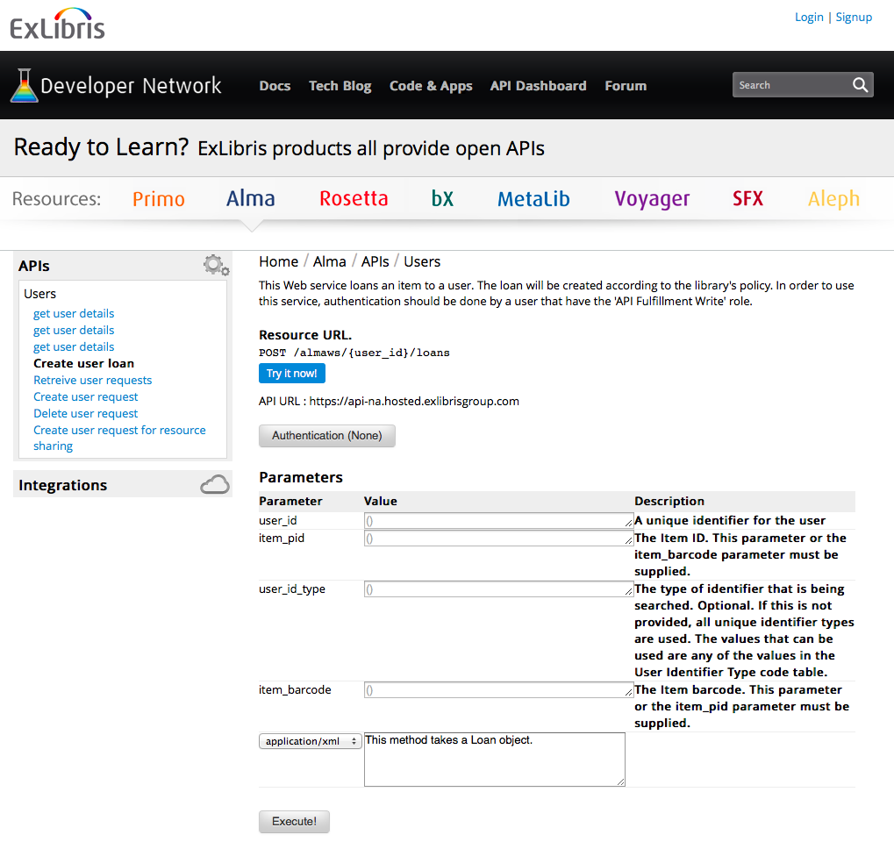
API Console – Easy to Learn & Test APIs

Slide 60
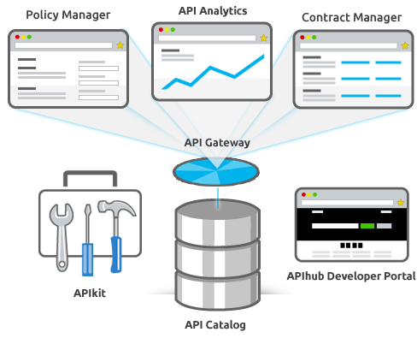
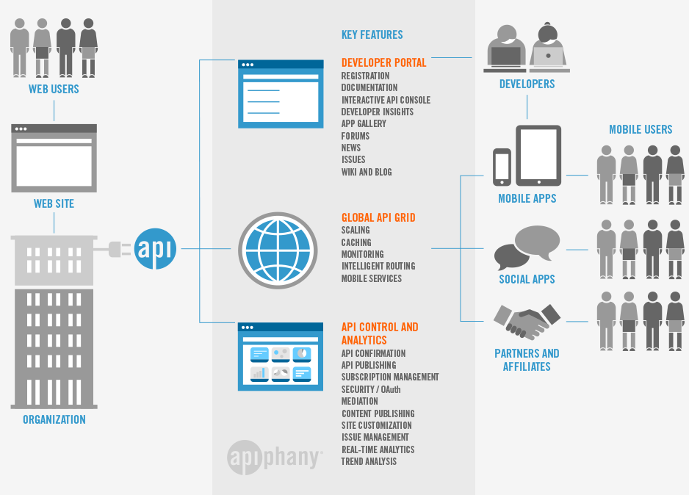
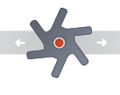

API Platform – Deploying a Secure & Scalable API Infrastructure
DEVELOPER PORTAL
Documentation
Tech Blog
Code & Apps
API Console
Forum
DEVELOPERS
API PROXY
Access Control
Threat Protection
Routing
Caching
Throttling
api
MOBILE APPS
API CONTROL & ANALYTICS
Policy Management
Versioning
API Analytics
API Monitoring
Auditing
THIRD PARTY APPS
INTEGRATIONS

Slide 61
Alma Developers
Publishing
APIs
Data Extract & Import
Course
Management
Bursar
Systems
Finance
Systems
Mobile
Student
Info
Systems
Bulk BIB Record Manipulation
Resource
Sharing
Vendor
Systems

Slide 62
API’s In Action by Our Customers
Patron card via portal
Custom Portal/discovery
Real time synchronization with SIS
Sentry Security Gate check
Cash payment integration
Course Reading List for Mobile
Reading Lists integration

Slide 63
Alma Cloud

Slide 64
Running on Industry leading Cloud Datacenter
© Ex Libris Ltd., 2014 - Internal and Confidential

Slide 65
Ex Libris Worldwide Data Centers
Chicago
Amsterdam
Singapore

Slide 66











Goal - Relentless on Security
  Physical
24/7 security, biometric authentication,
video surveillance, authorized personnel
  Infrastructure
Hardening, change management procedures , patch management, password policy
  Network
Vulnerability scans, Intrusion Prevention System (IPS), TLS/SSL encrypted communication
  Application
Security Development Lifecycle (SDL), Penetration tests, OWASP Top10
  Data
Data isolation (Oracle VPD), encryption, media
sanitization (DoD 5220.22-M)
  Identity & Access Control
SSO, S/LDAP, SAML/Shibboleth, Role-Based Access
Control (RBAC)
  Business Continuity
High availability, database cluster, storage redundancy, frequent snapshots, offsite backups, 24x7 HUB
  Monitoring & Incident Mgmt
24x7 monitoring, Chief Security Officer (CSO),
security breach notification
  Human Resources
Security awareness training, confidentiality
agreements, adherence to regulations
  Compliance & Audit
ISO 27001, SSAE-16 , EU Safe Harbor, Data processing agreements, independent audit

Slide 67
Ex Libris Cloud
Global Facilities
Data Centers SSAE16 SOC1 and ISO-27001 certified
24/7 Personnel
Redundant Cooling / Humidity systems
Multiple Network Vendors
Redundant power systems including UPS and generators

Slide 68
System Management
Server, network and DBA
Application
Support and service calls
O/S management
Oracle upgrades
Back-ups
Disaster recovery
Test environments
Security infrastructure
Service packs
Version upgrades
Client deployment
Sandbox environment
Diagnostics
Implementing proposed fixes and testing solutions
Capacity planning & tuning
Logging-debugging
Firewall
Command line
Liaison between local server/app teams and Ex Libris
Configuration and customization
Logging & tracking service calls
Green = cloud managed
Purple = changed
Blue = unchanged

Slide 69
Why Moving to Alma?
Streamlined Workflows
Enhanced Patron Experience
Improved Productivity
Single unified solution for Print, Electronic and Digital
Sophisticated discovery integration (Primo)
Workflow Automation (Exception-based tasks list)
Optimized Collection Usage
Unique and
Shared Data
Interoperability & Extended Services
Comprehensive Analytics (Data-Driven Decisions)
Hybrid model – institution & community zone
Open Platform, APIs & Integrations
Decreased Complexity & Silos
Maximized Flexibility
Unprecedented Collaboration
Unified Resource Management (multi-format metadata)
Depth of functionality & High degree of conﬁgurability
Collaborative Networks

Slide 70

Thank You
Thank You

